Slide 1
WRES2203 Advanced Network Technology
Chapter 6
EIGRP

Slide 2
Contents
Introduction
Packet Type
Operation
Metric
DUAL
Configuration
Configuration for IPv6
Advanced Configuration
Authentication

Slide 3
Introduction
Enhanced Interior Gateway Routing Protocol (EIGRP) is an advanced distance vector, classless routing protocol.
EIGRP is distance vector because information about the rest of the network is learned from directly connected neighbors.
In 2013, Cisco released a basic functionality of EIGRP as an open standard.

Slide 4
Introduction
EIGRP includes several advanced features
  Diffusing Update Algorithm (DUAL)
    Guarantees loop-free and backup paths throughout the routing domain.
    Stores all available backup routes for destinations so that it can quickly adapt to alternate routes when necessary.
  Establishing Neighbor Adjacencies
    Establishes relationships with directly connected routers that are also enabled for EIGRP.
  Reliable Transport Protocol (RTP)
    Provides delivery of EIGRP packets to neighbors.

Slide 5
Introduction
  Partial and Bounded Updates
    Does not send periodic updates and route entries do not age out.
    Partial update only includes information about the route changes, such as a new link or a link becoming unavailable.
    Bounded refers to the propagation of partial updates that are sent only to those routers that the changes affect.
  Equal and Unequal Cost Load Balancing
    Better distribute traffic flow in their networks

Slide 6
Introduction
EIGRP has the capability for routing several different protocols including IPv4 and IPv6 using Protocol-Dependent Modules (PDMs).
PDM
  Maintaining the neighbor and topology tables.
  Building and translating packets for DUAL
  Interfacing DUAL to the routing table
  Computing the metric and pass to DUAL
  Implementing filtering and access lists
  Performing redistribution functions to and from other routing protocols
  Redistributing routes that are learned by other routing protocols

Slide 7
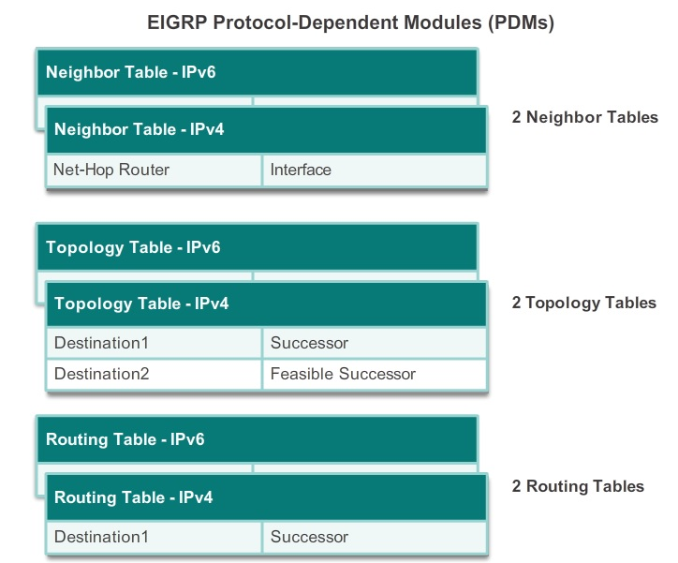
Introduction

Slide 8
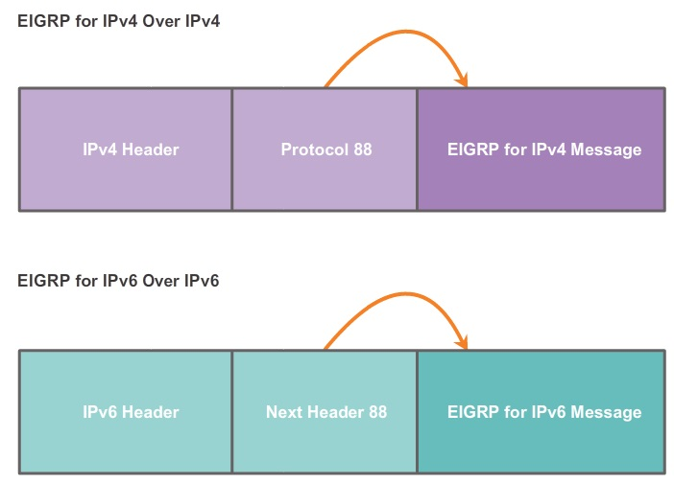
Introduction

Slide 9
Introduction
EIGRP uses Reliable Transport Protocol (RTP) for the delivery and reception of EIGRP packets.
Reliable RTP requires an acknowledgment to be returned by the receiver to the sender. Example, an EIGRP update packet
An unreliable RTP packet does not require an acknowledgment. Example, Hello packets.
RTP can send EIGRP packets as unicast or multicast
  Multicast EIGRP packets for IPv4 (224.0.0.10)
  Multicast EIGRP packets for IPv6 (FF02::A)

Slide 10
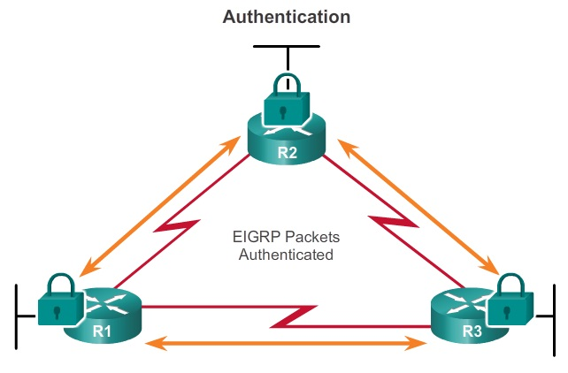
Introduction
EIGRP can be configured for authentication.

Slide 11
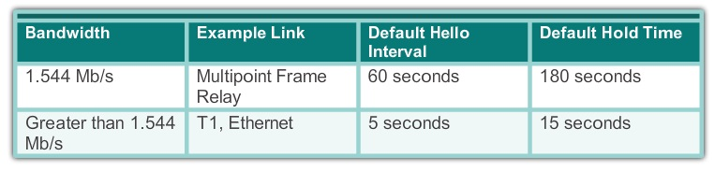
Packet Type
Hello packets
  Used for neighbor discovery and to maintain neighbor adjacencies.
  Sent with unreliable delivery
  Unicast (60 seconds) / Multicast (5 seconds)

Slide 12
Packet Type
Update packets
  Propagates routing information to EIGRP neighbors.
  Sent with reliable delivery
  Unicast or multicast
Acknowledgment packets
  Acknowledge the receipt of an EIGRP message that was sent using reliable delivery.
  Sent with unreliable delivery
  Unicast

Slide 13
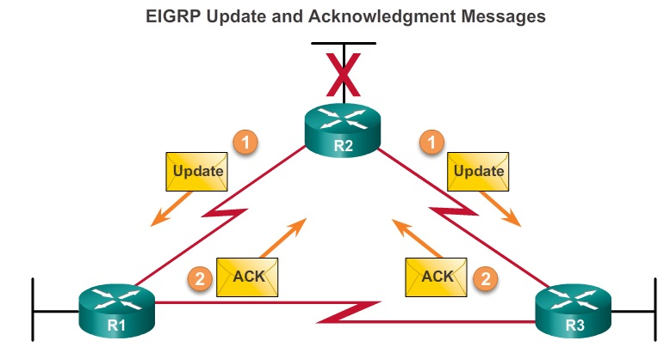
Packet Type

Slide 14
Packet Type
Query packets
  Query routes from neighbors.
  Sent with reliable delivery
  Unicast or multicast
Reply packets
  Response to an EIGRP query.
  Sent with unreliable delivery
  Unicast

Slide 15
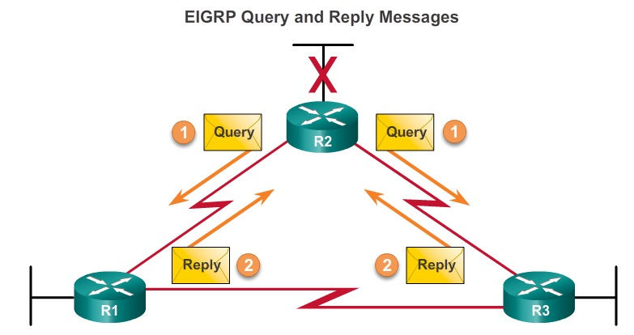
Packet Type

Slide 16
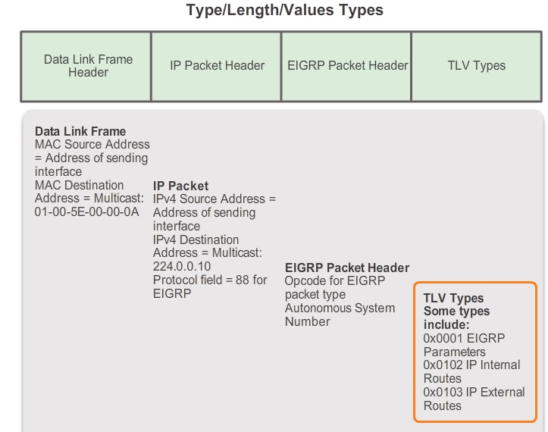
Packet Type

Slide 17
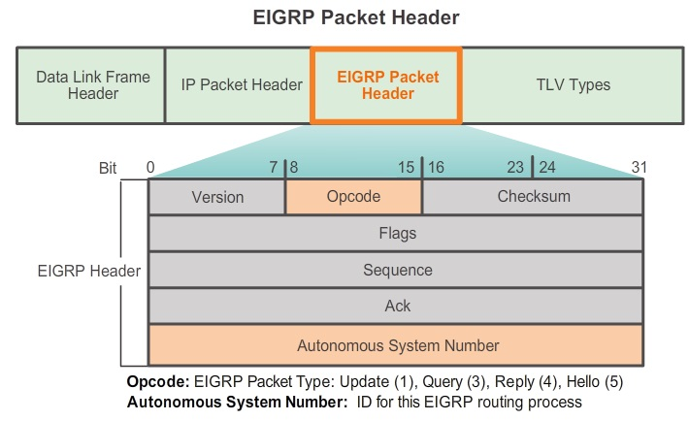
Packet Type

Slide 18
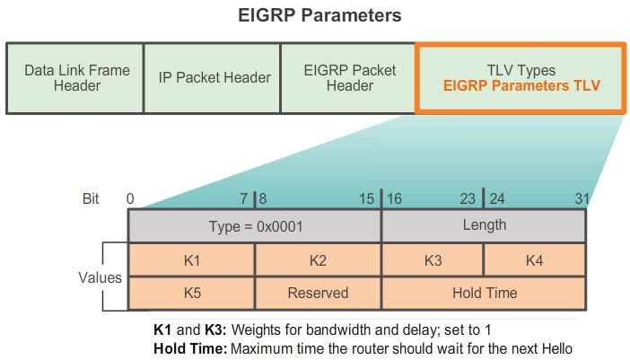
Packet Type

Slide 19
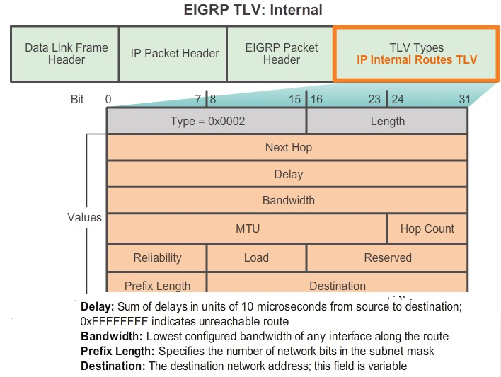
Packet Type

Slide 20
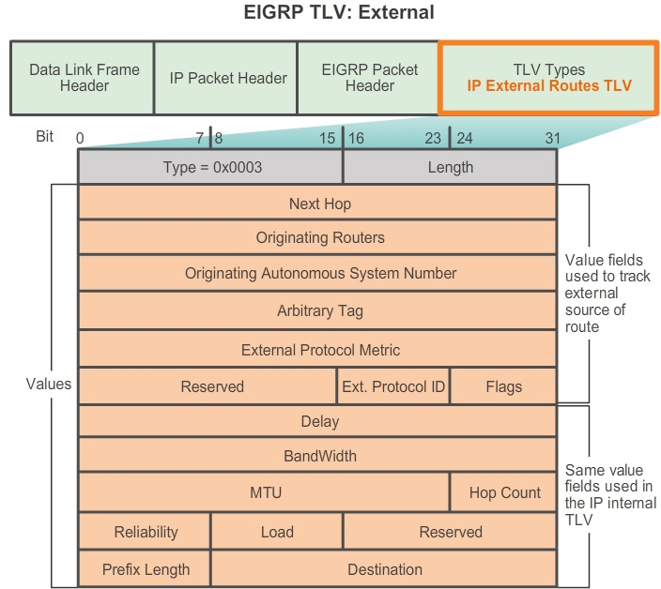
Packet Type

Slide 21
Operation
Before any EIGRP update packets can be exchanged between routers, EIGRP must first discover its neighbors.
EIGRP uses Hello packets to establish and maintain neighbor adjacencies.
Each EIGRP router maintains a neighbor table, which contains a list of routers on shared links that have an EIGRP adjacency with this router. The neighbor table is used to track the status of these EIGRP neighbors.

Slide 22
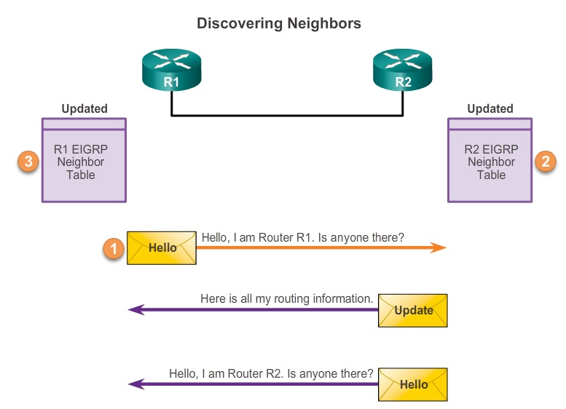
Operation

Slide 23
Operation
EIGRP updates contain networks that are reachable from the router sending the update. As EIGRP updates are exchanged between neighbors, the receiving router adds these entries to its EIGRP topology table.
Each EIGRP router maintains a topology table for each routed protocol configured, such as IPv4 and IPv6.
The topology table includes route entries for every destination that the router learns from its directly connected EIGRP neighbors.

Slide 24
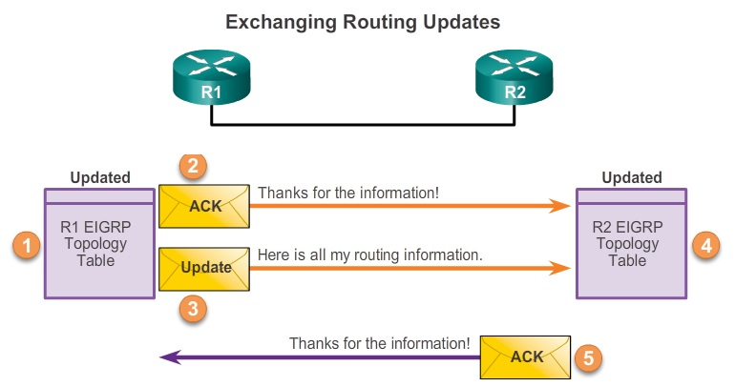
Operation

Slide 25
Operation
After receiving the EIGRP update packets from R2, using the information in the topology table, R1 updates its IP routing table with the best path to each destination, including the metric and the next-hop router.
Similar to R1, R2 updates its IP routing table with the best path routes to each network.
At this point, EIGRP on both routers is considered to be in the converged state.

Slide 26
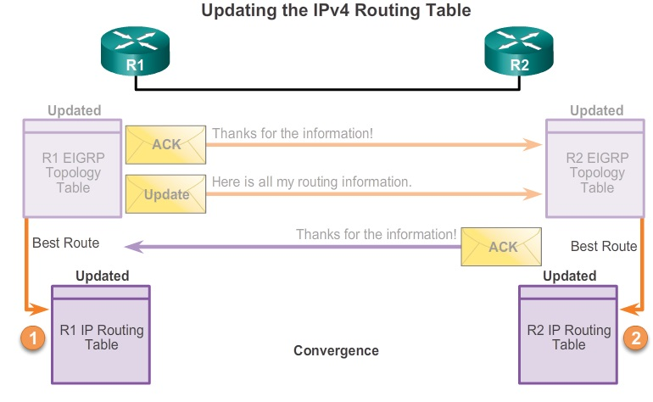
Operation

Slide 27
Metric
EIGRP uses the following values in its composite metric to calculate the preferred path to a network:
  Bandwidth
    The slowest bandwidth among all of the outgoing interfaces, along the path from source to destination.
    kbps
  Delay
    The cumulative (sum) of all interface delay along the path
    microseconds

Slide 28
Metric
  Reliability
    The worst reliability between the source and destination, which is based on keep-alives.
    255 is 100%
  Load
    The worst load on a link between the source and destination, which is computed based on the packet rate and the configured bandwidth of the interface.
    255/255 is completely saturated
K1 and K3 are set to 1, and K2, K4, and K5 are set to 0.
  router ospf 1
    metric weights tos k1 k2 k3 k4 k5

Slide 29
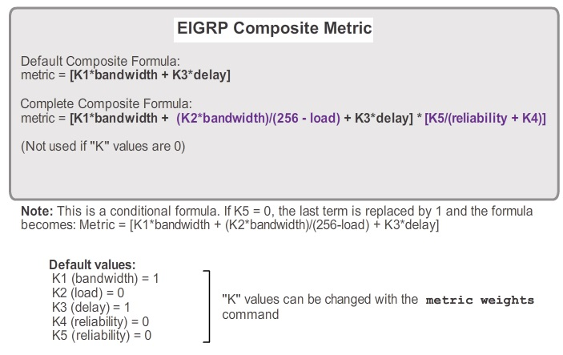
Metric

Slide 30
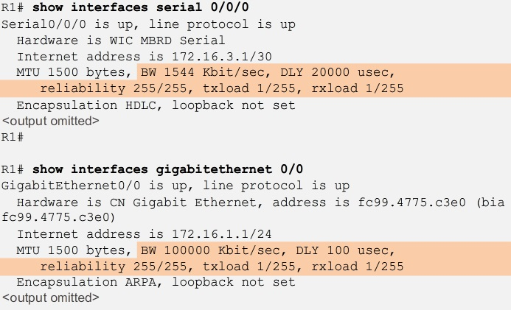
Metric

Slide 31

Metric
Most serial interfaces use the default bandwidth value of 1544 kbps
  bandwidth kilobits-bandwidth-value

Slide 32
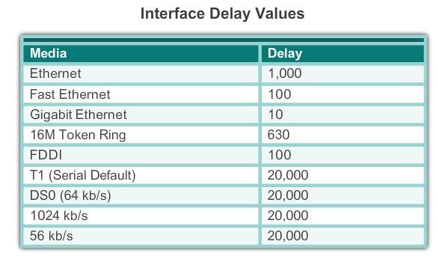
Metric

Slide 33
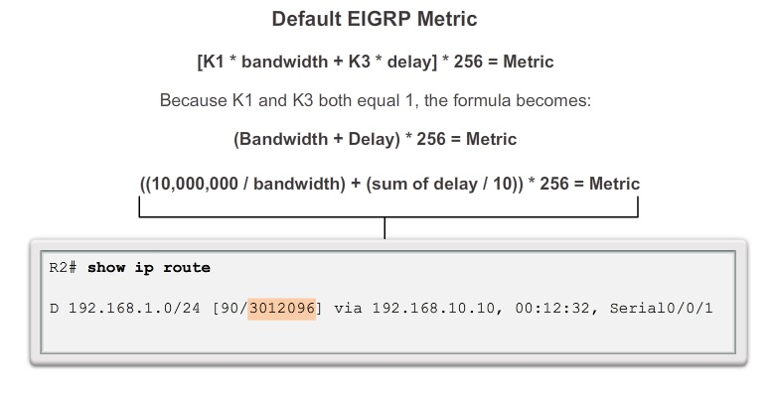
Metric

Slide 34
DUAL
EIGRP uses the Diffusing Update Algorithm (DUAL) to provide the best loop-free path and loop-free backup paths.
The DUAL algorithm is used to obtain loop-freedom at every instance throughout a route computation.
Routers that are not affected by the topology changes are not involved in the re-computation.
The decision process for all route computations is done by the DUAL Finite State Machine (FSM).
  A finite number of stages (states)
  Transitions between those stages
  Operation
  debug eigrp fsm

Slide 35
DUAL
DUAL uses several terms
  Successor
  Feasible Distance (FD)
  Feasible Successor (FS)
  Reported Distance (RD) or Advertised Distance (AD)
  Feasible Condition or Feasibility Condition (FC)
A successor is a neighboring router that is used for packet forwarding and is the least-cost route to the destination network.
Feasible Distance is the lowest calculated metric to reach the destination network

Slide 36
DUAL
Feasible Successor is a neighbor that has a loop-free backup path to the same network as the successor, and it satisfies the Feasibility Condition (FC).
The FC is met when a neighbor’s Reported Distance (RD) to a network is less than the local router’s FD to the same destination network. If the reported distance is less, it represents a loop-free path.
The reported distance is simply an EIGRP neighbor’s feasible distance to the same destination network.

Slide 37
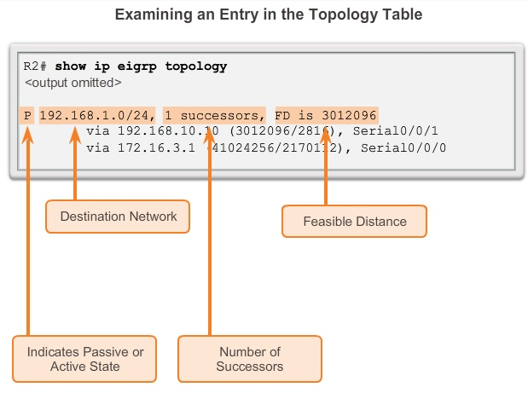
DUAL

Slide 38
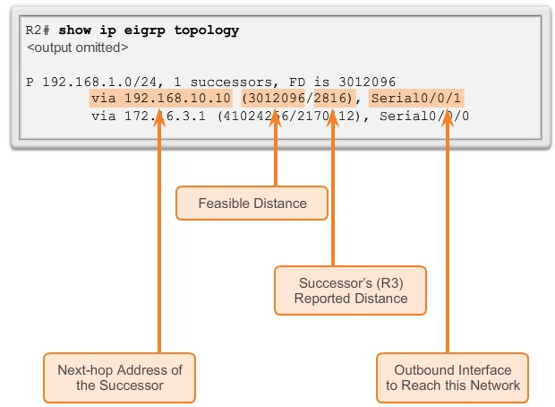
DUAL

Slide 39
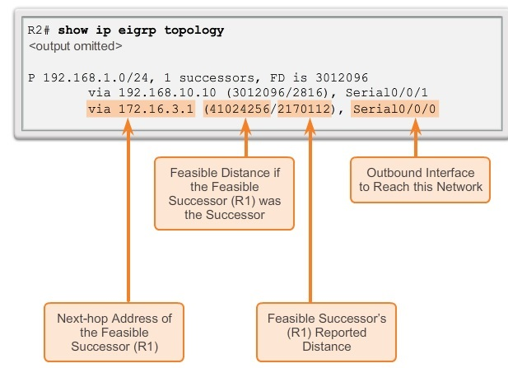
DUAL

Slide 40
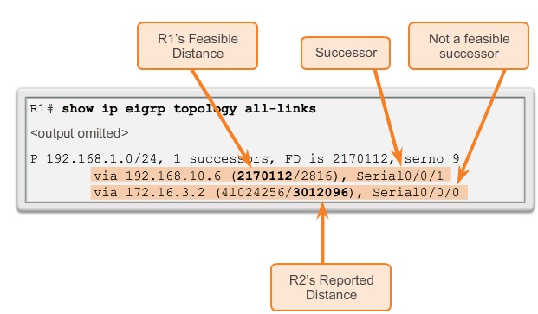
DUAL

Slide 41
Configuration
Enable EIGRP process
  router eigrp autonomous-system
Autonomous system number referred to in the EIGRP configuration is not associated with the Internet Assigned Numbers Authority (IANA) AS.
The autonomous system number used for EIGRP configuration is only significant to the EIGRP routing domain.
It functions as a process ID to help routers keep track of multiple running instances of EIGRP.
The AS can be assigned between 1 and 65,535.
All routers in the same routing domain must configure with the same AS.

Slide 42
Configuration
EIGRP router ID is used to uniquely identify each router in the EIGRP routing domain.
EIGRP for IPv4 uses the 32-bit router ID.
  eigrp router-id 32-bit-router-id
If the router ID is not configured, the router chooses the highest IPv4 address of any of its loopback interfaces.
If no loopback interfaces are configured, the router chooses the highest active IPv4 address of any of its physical interfaces.

Slide 43
Configuration
Configure the directly connected classful network.
  network classful-network
Configure EIGRP to advertise specific subnets
  network network-address [wildcard-mask]
passive-interface
  To suppress unnecessary update traffic, such as when an interface is a LAN interface, with no other routers connected
  To increase security controls, such as preventing unknown rogue routing devices from receiving EIGRP updates

Slide 44
Configuration
By default, EIGRP automatically summarizes. We can disable the automatic summarization with the no auto-summary command.
By default, the eigrp log-neighbor-changes is enabled.
  Display any changes in EIGRP neighbor adjacencies.
  Help verify neighbor adjacencies during configuration of EIGRP.

Slide 45
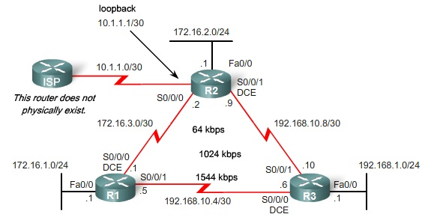
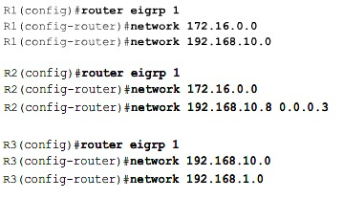
Configuration

Slide 46
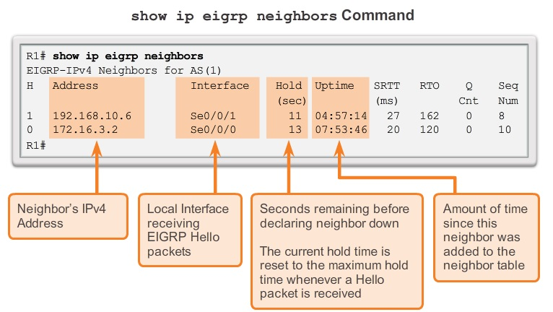
Configuration

Slide 47
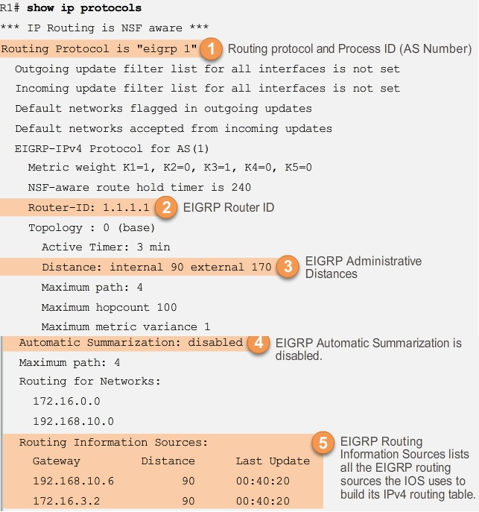

Slide 48
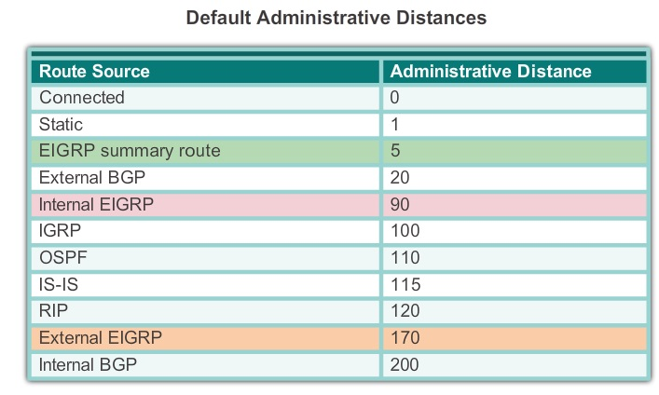
Configuration

Slide 49
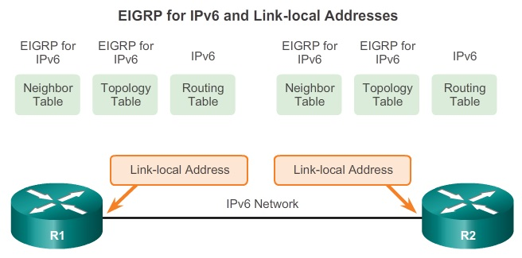
Configuration for IPv6
IPv6 link-local address enables a device to communicate with other IPv6-enabled devices on the same link and only on that link (subnet).
IPv6 link-local addresses are in the FE80::/10 range.

Slide 50
Configuration for IPv6
EIGRP for IPv6 messages are sent using:
  Source IPv6 address
    IPv6 link-local address of the exit interface.
  Destination IPv6 address
    When the packet needs to be sent to a multicast address, it is sent to the IPv6 multicast address FF02::A, the all-EIGRP-routers with link-local scope.
    If the packet can be sent as a unicast address, it is sent to the link-local address of the neighboring router.

Slide 51
Configuration for IPv6
Link-local addresses are automatically created when an IPv6 global unicast address is assigned to the interface.
Link-local addresses can be configured manually
  ipv6 address link-local-address link-local
To enables IPv6 routing on the router.
  ipv6 unicast-routing
Enable EIGRP for IPv6
  ipv6 router eigrp autonomous-system
  eigrp router-id 32-bit-router-id
  no shutdown

Slide 52
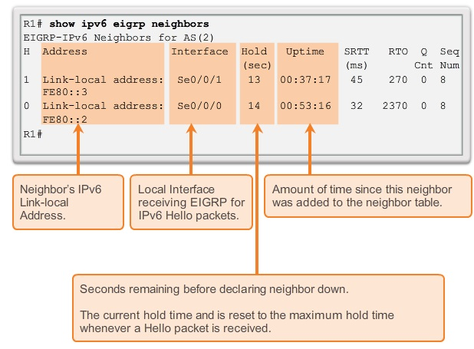
Configuration for IPv6
Enable EIGRP on Interface
  ipv6 eigrp autonomous-system

Slide 53
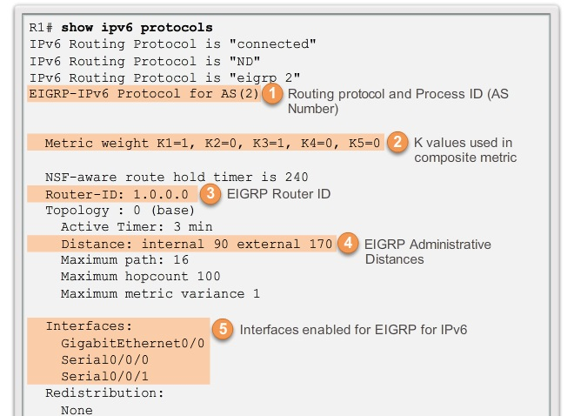
Configuration for IPv6

Slide 54
Advanced Configuration
Route summarization allows a router to group networks together and advertises them as one large group using a single, summarized route.
Summarization decreases the number of entries in routing updates and lowers the number of entries in local routing tables
EIGRP use automatic summarization at classful boundaries.
EIGRP for IPv4 automatic summarization is disabled by default beginning with Cisco IOS Release 15.0(1)M and 12.2(33).

Slide 55
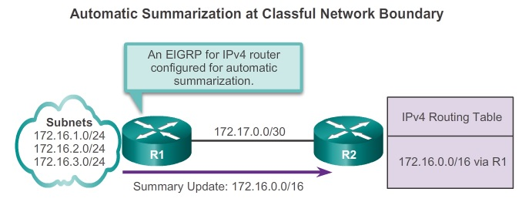
Advanced Configuration

Slide 56
Advanced Configuration
To disable automatic summarization for EIGRP
  no auto-summary
To enable automatic summarization for EIGRP
  auto-summary
Verify automatic summarization
  show ip protocols
  show ip eigrp topology all-links
  show ip route eigrp

Slide 57
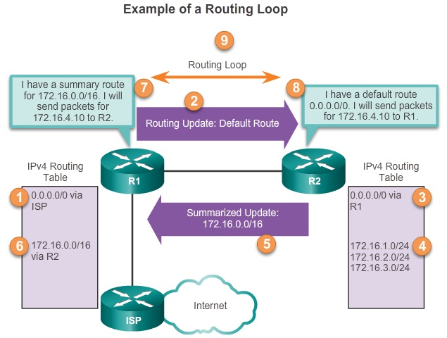
Advanced Configuration
Automatic summarization can cause routing loop in EIGRP. EIGRP uses the Null0 interface to prevent routing loops.

Slide 58
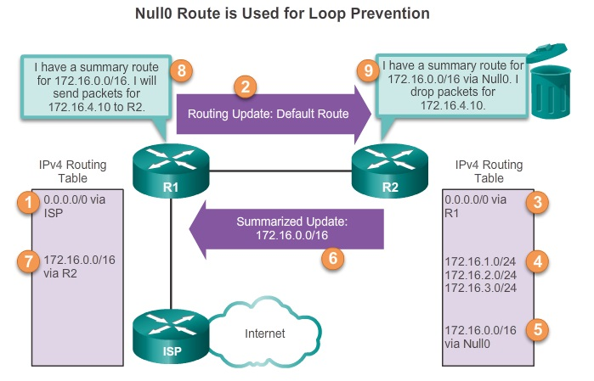
Advanced Configuration
Null0 interface is a virtual interface that is a route to nowhere. Packets are discarded when forward to Null0 interface.

Slide 59
Advanced Configuration
To establish EIGRP manual summarization on a specific EIGRP interface.
  ip summary-address eigrp as-number network-address subnet-mask
  ipv6 summary-address eigrp as-number prefix/prefix-length
To propagating a static default route within the EIGRP routing domain is by using the
  redistribute static
  The command tells EIGRP to include static routes in its EIGRP updates to other routers.
  D*EX

Slide 60
Advanced Configuration
By default, EIGRP uses only up to 50 percent of an interface’s bandwidth for EIGRP information.
  ip bandwidth-percent eigrp as-number percent
  ipv6 bandwidth-percent eigrp as-number percent
Hello and Hold
  ip hello-interval eigrp as-number seconds
  ip hold-time eigrp as-number seconds
  ipv6 hold-time eigrp as-number seconds
  ipv6 hello-interval eigrp as-number seconds

Slide 61
Advanced Configuration
Equal-cost load balancing is the ability of a router to distribute outbound traffic using all interfaces that have the same metric from the destination address.
Load balancing uses network segments and bandwidth more efficiently.
Cisco IOS, by default, load balancing using up to four equal-cost paths, can configure up to 32.
  maximum-paths value

Slide 62
Authentication
EIGRP message authentication ensures that routers only accept routing messages from other routers that know the same pre-shared key.
EIGRP supports routing protocol authentication using MD5.
Step 1. Create a Keychain and Key
  key chain name-of-chain
  key key-id
    The range of keys is from 0 to 2,147,483,647
  key-string key-string-text

Slide 63
Authentication
Step 2. Configure EIGRP Authentication Using Keychain and Key
  interface type number
    ip authentication mode eigrp as-number md5
    ip authentication key-chain eigrp as-number name-of-chain
    ipv6 authentication mode eigrp as-number md5
    ipv6 authentication key-chain eigrp as-number name-of-chain

Slide 64
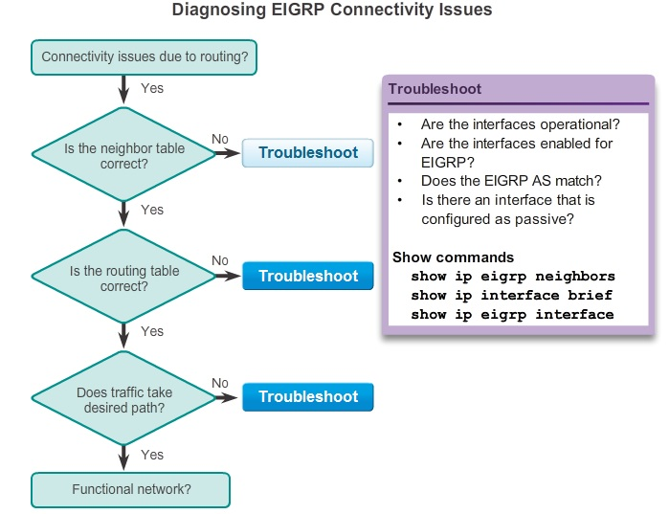
Authentication

